Slide 1


Installation of SQL Server

Slide 2

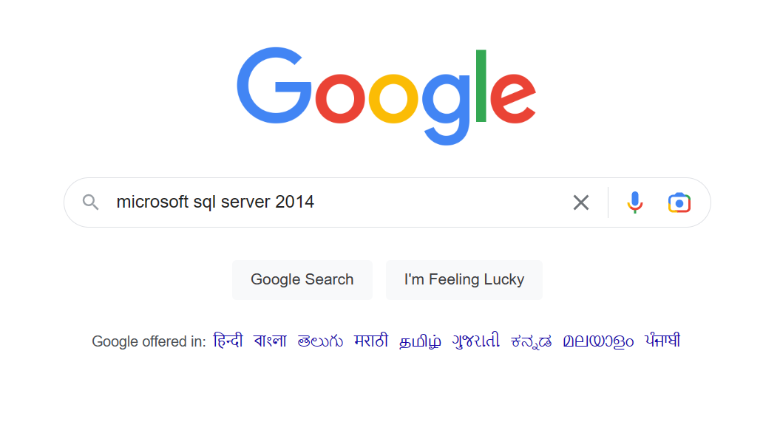

Step 1: Go on google and type microsoft sql server 2014

Slide 3

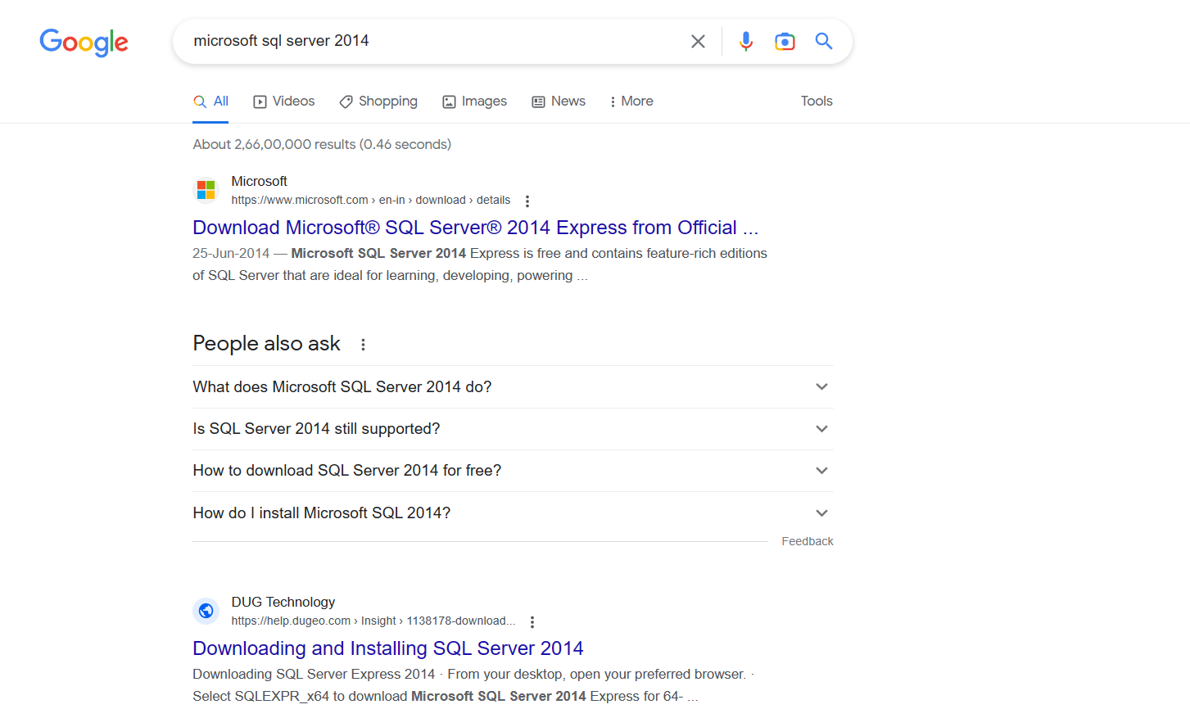
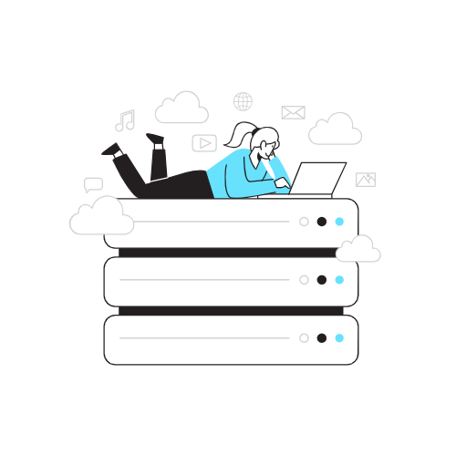
Step 2: Select the link (Download Microsoft® SQL Server® 2014 Express from Official Microsoft Download Center)

Slide 4

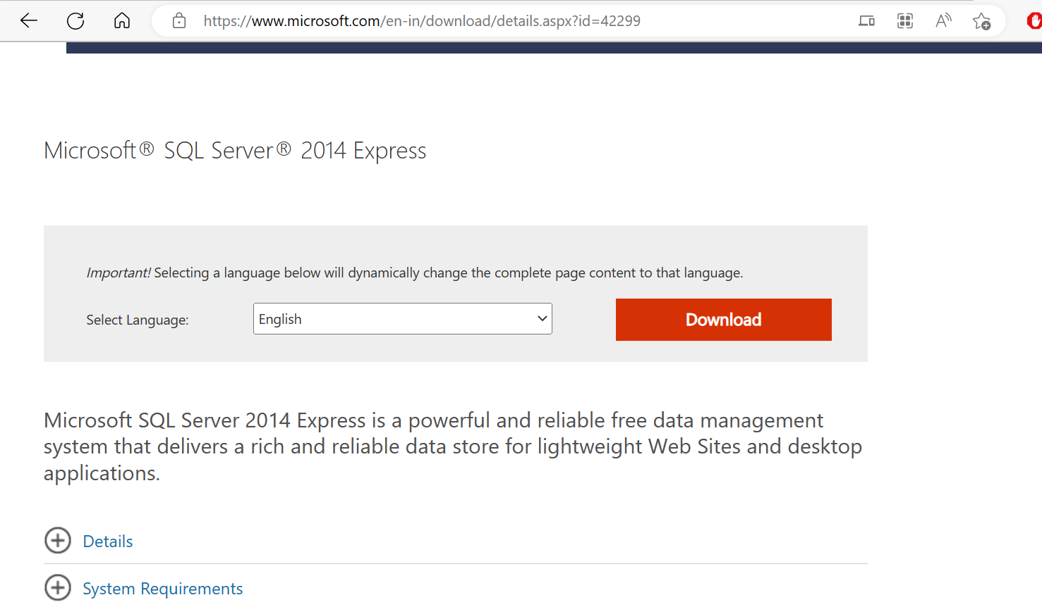

Step 3: Scroll down and click the download button

Slide 5

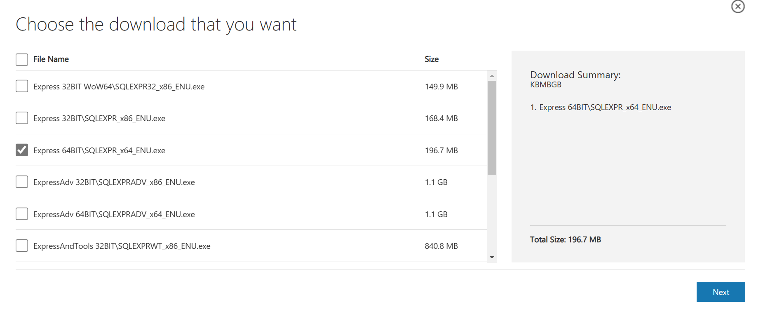

Step 4: Based on your system configuration download either 32 bit or the 64 bit version

Slide 6
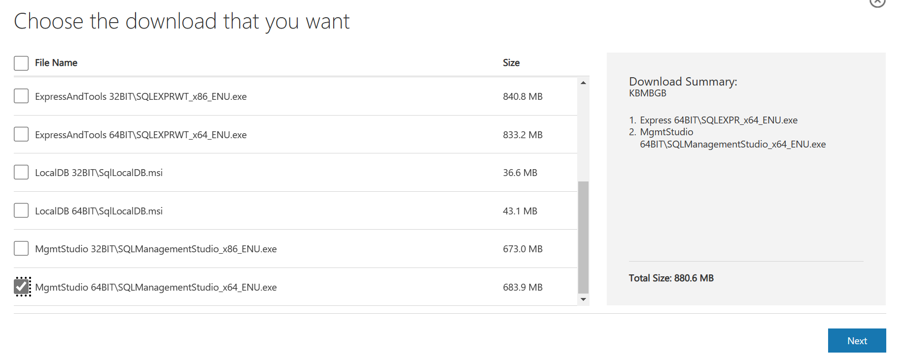

Step 5: Based on your system configuration download either 32 bit or the 64 bit version of management studio and click on next

Slide 7
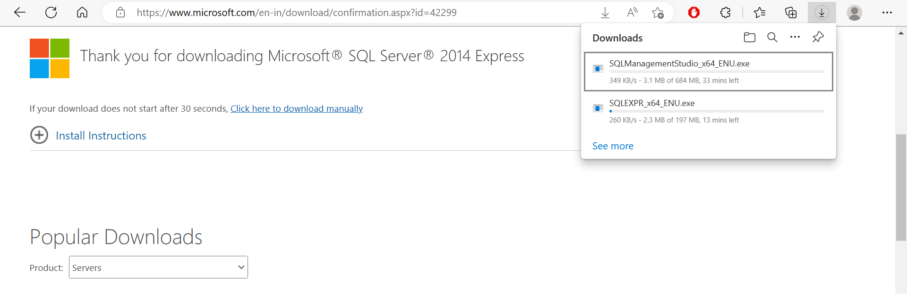

Step 6: After clicking next the download with start , wait till it get completely downloaded

Slide 8
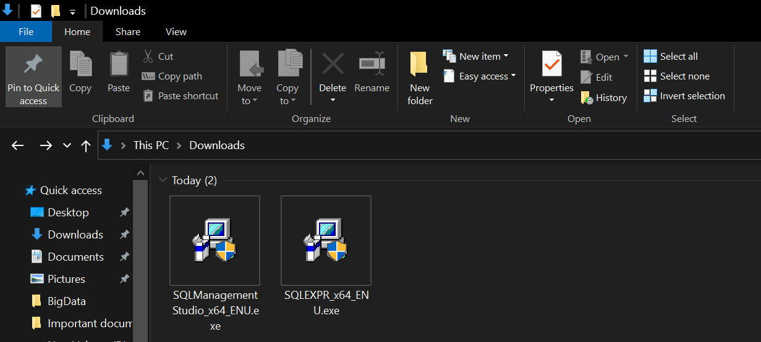

Step 7: Go to the folder where it got downloaded and click on SQLEXPR.exe

Slide 9
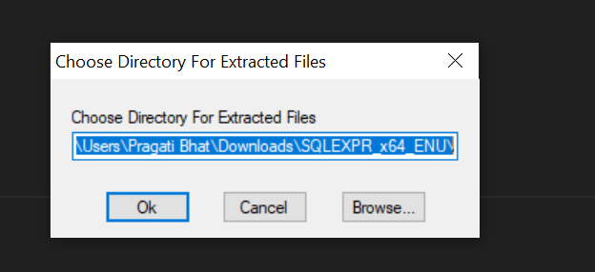

Step 8: Click on Ok

Slide 10
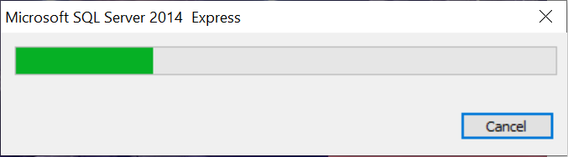

Step 9: Let it download

Slide 11
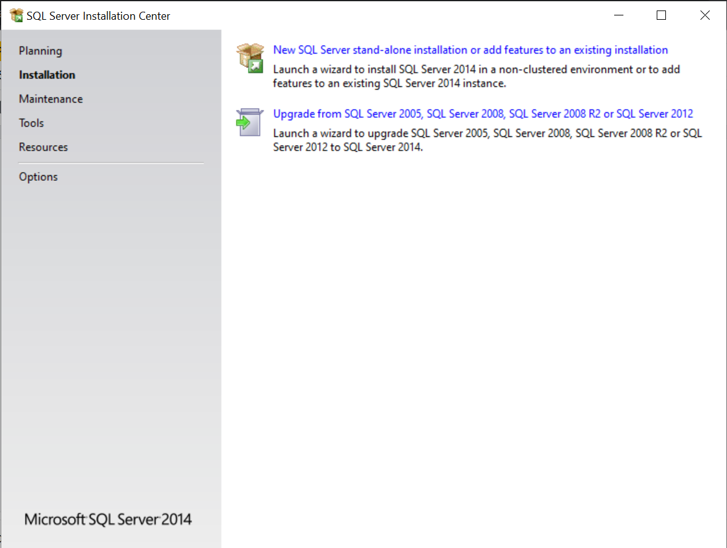


Step 10: Click the first link

Slide 12

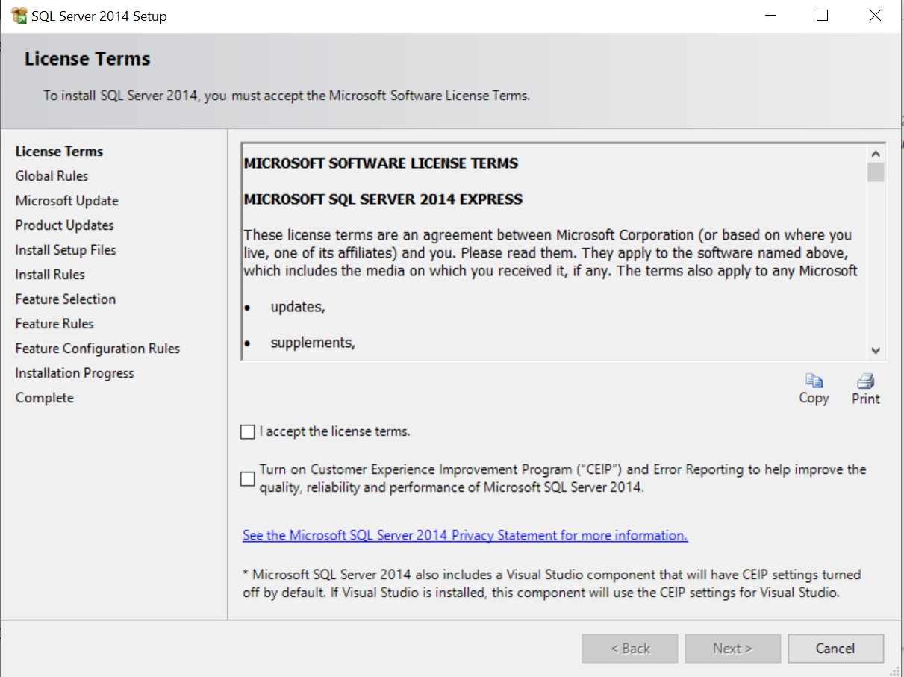

Step 11: Click on I accept the license terms

Slide 13
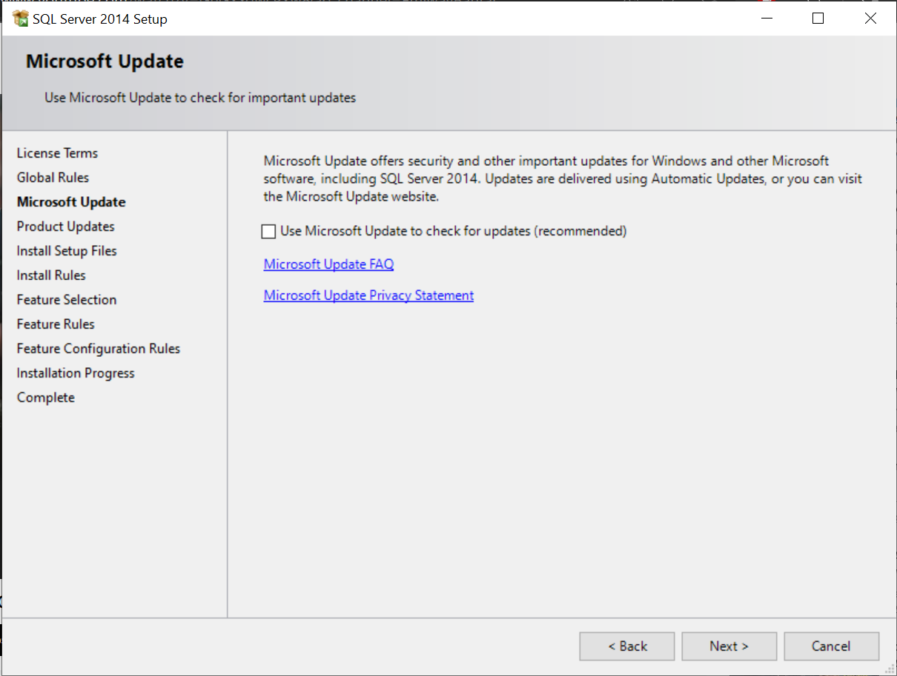


Step 12: Click on next

Slide 14
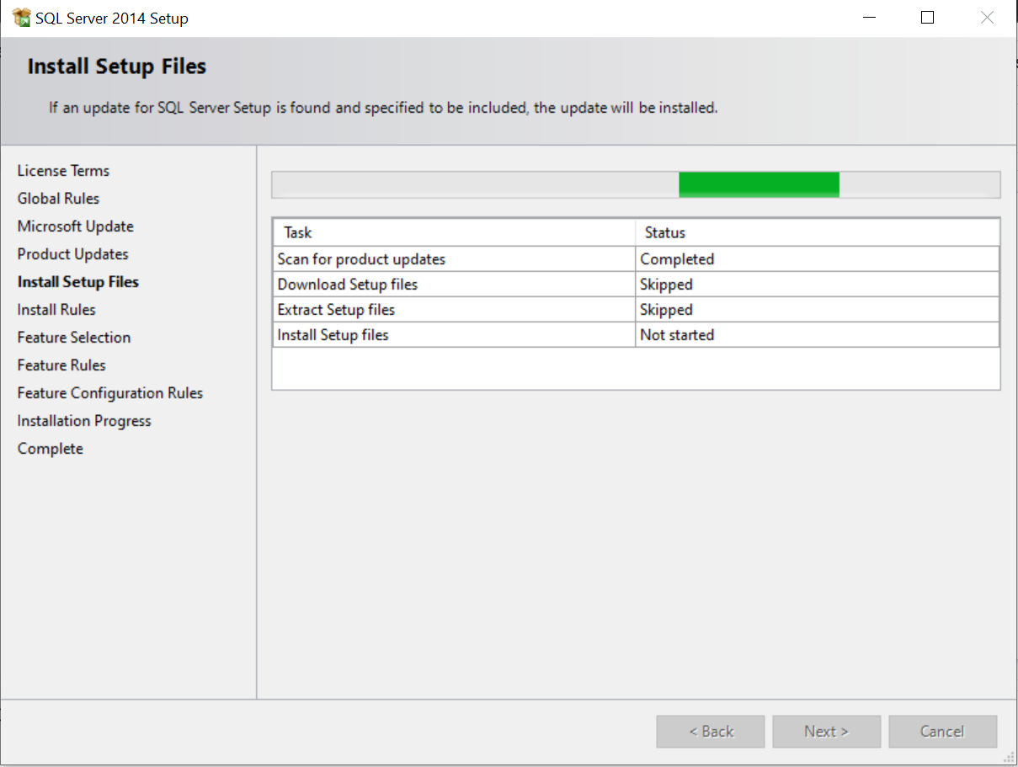


Step 13: Let setup files get downloaded

Slide 15

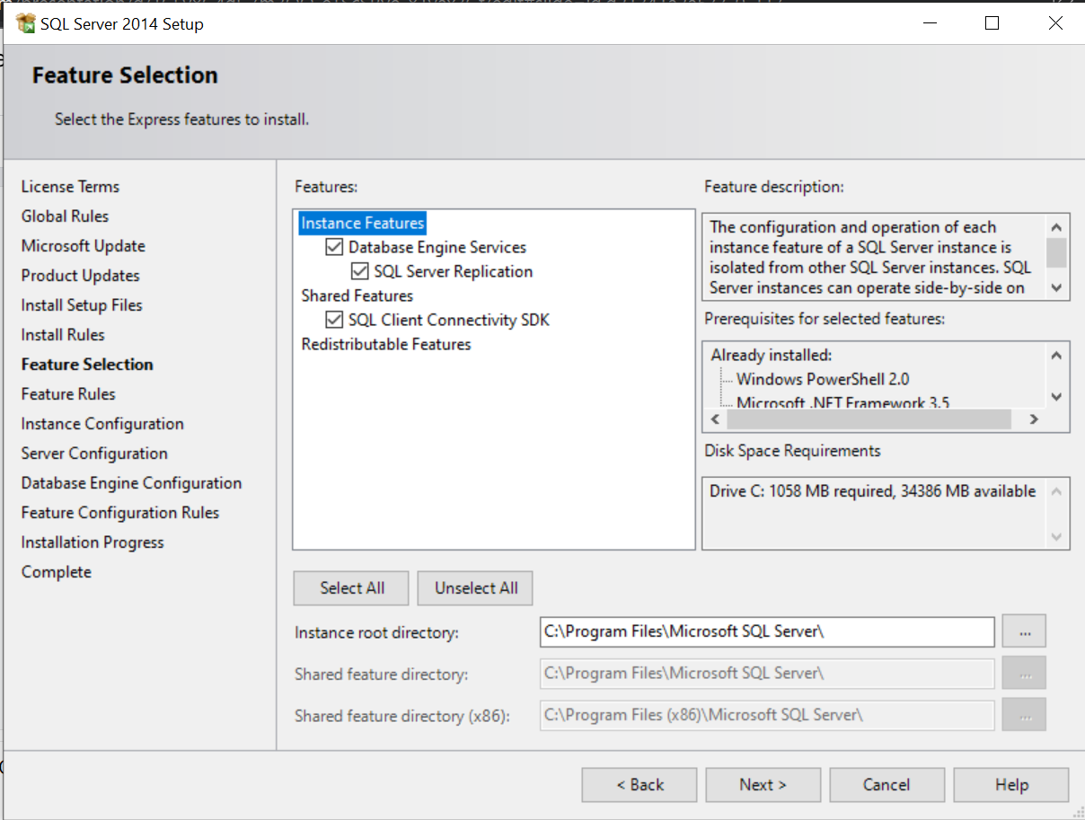

Step 14: Select all the features and select next

Slide 16

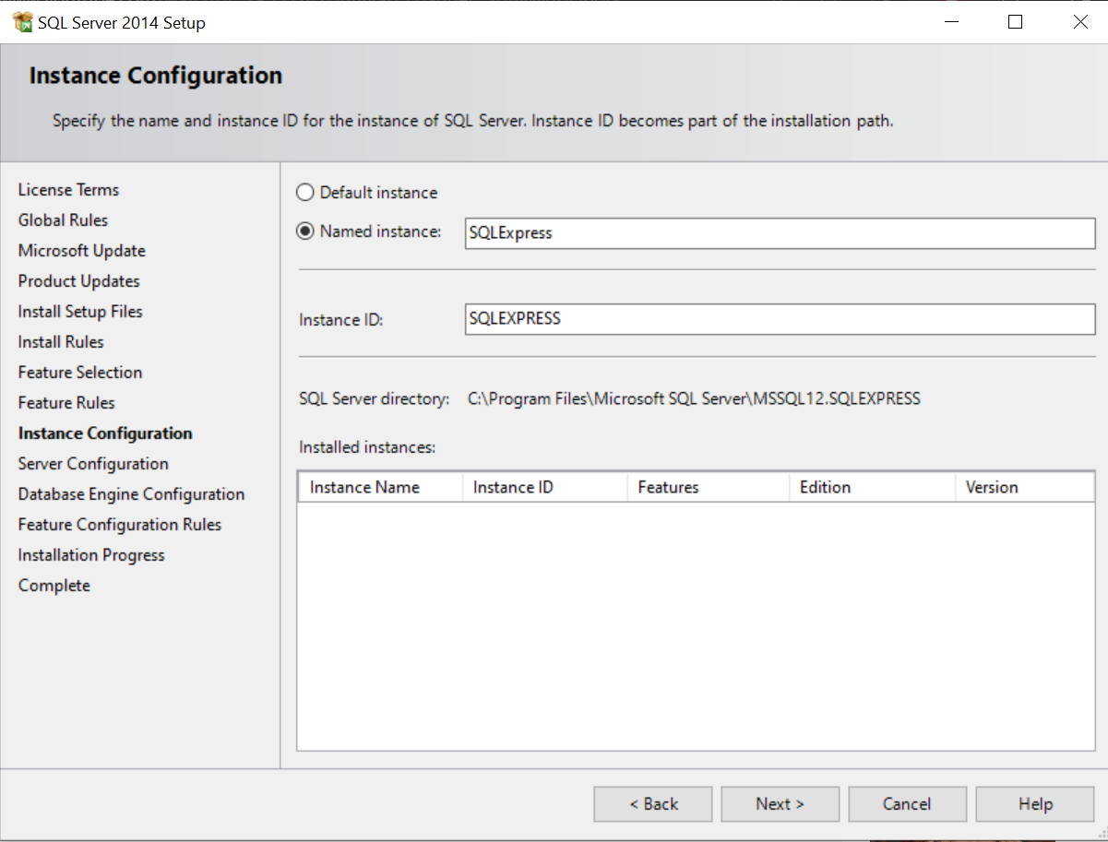

Step 15: Select default instance and then click next

Slide 17
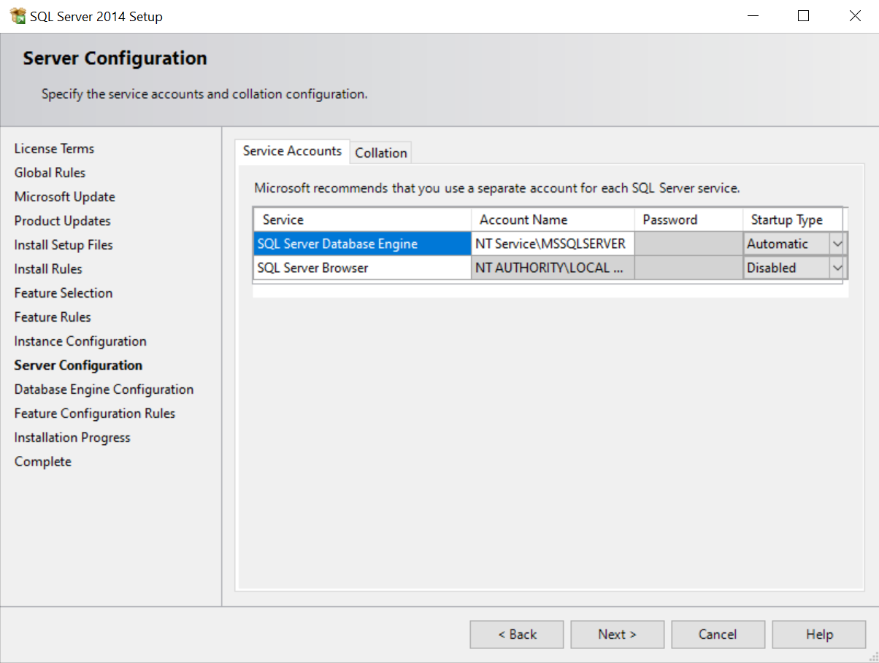


Step 16: Click next

Slide 18

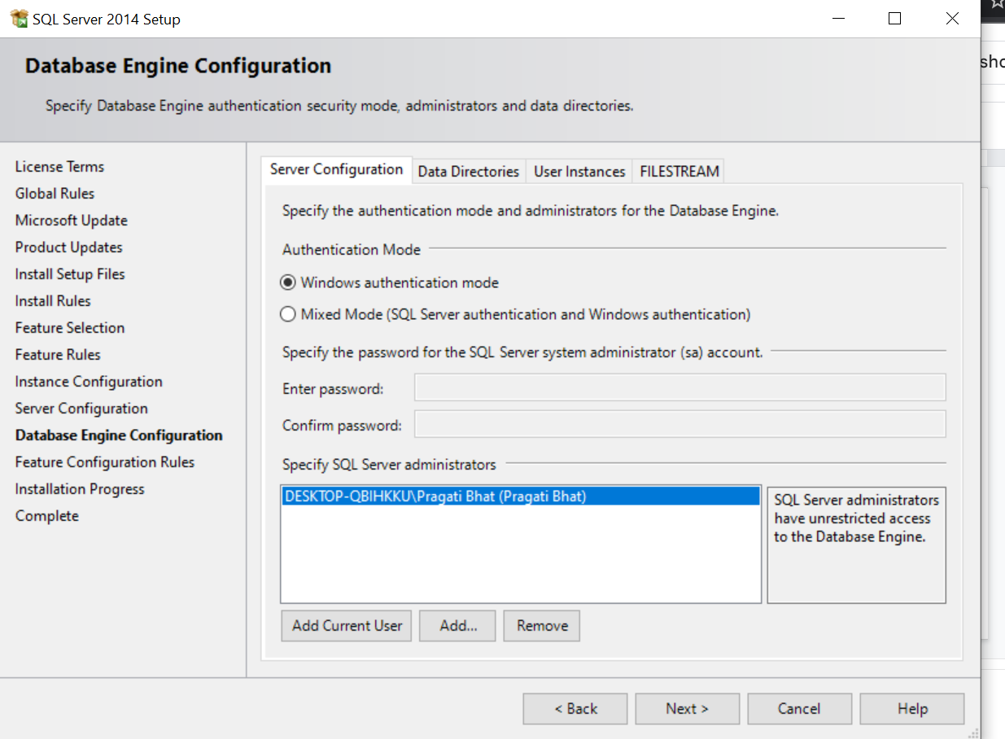

Step 17: Select Mixed Mode

Slide 19
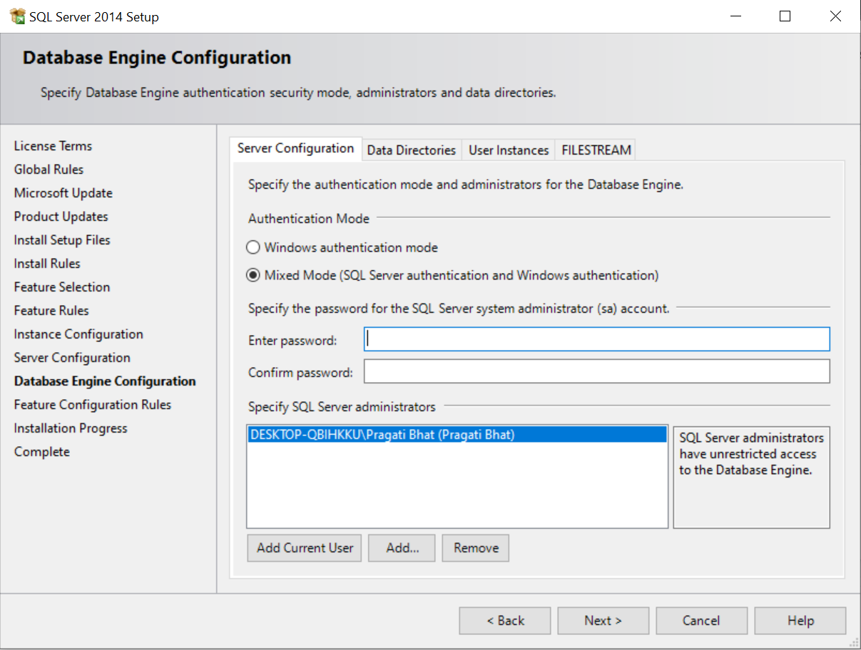


Step 18: Set the password

Slide 20

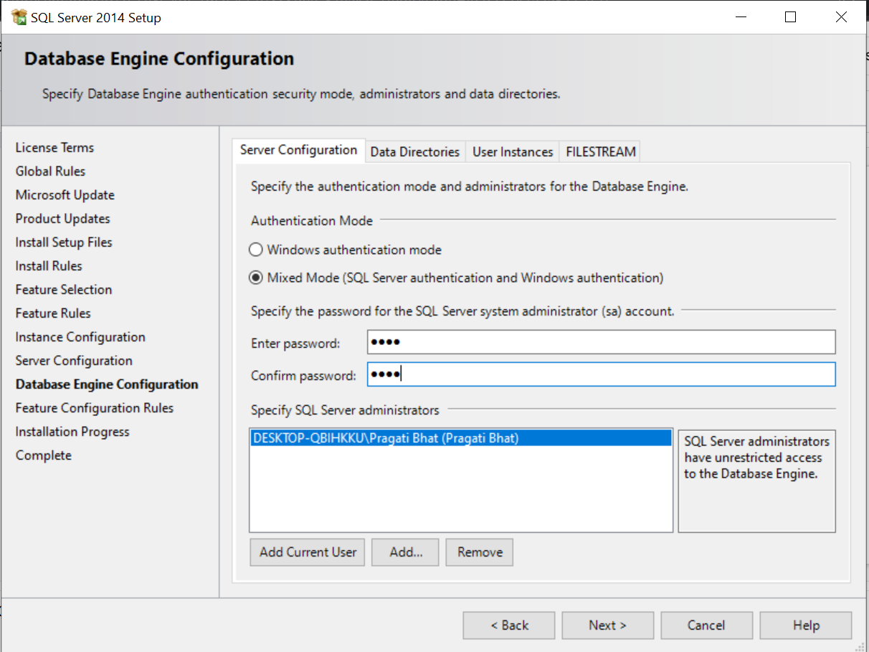
Step 19: You need to remember this password for further uses in sql and then click next

Slide 21

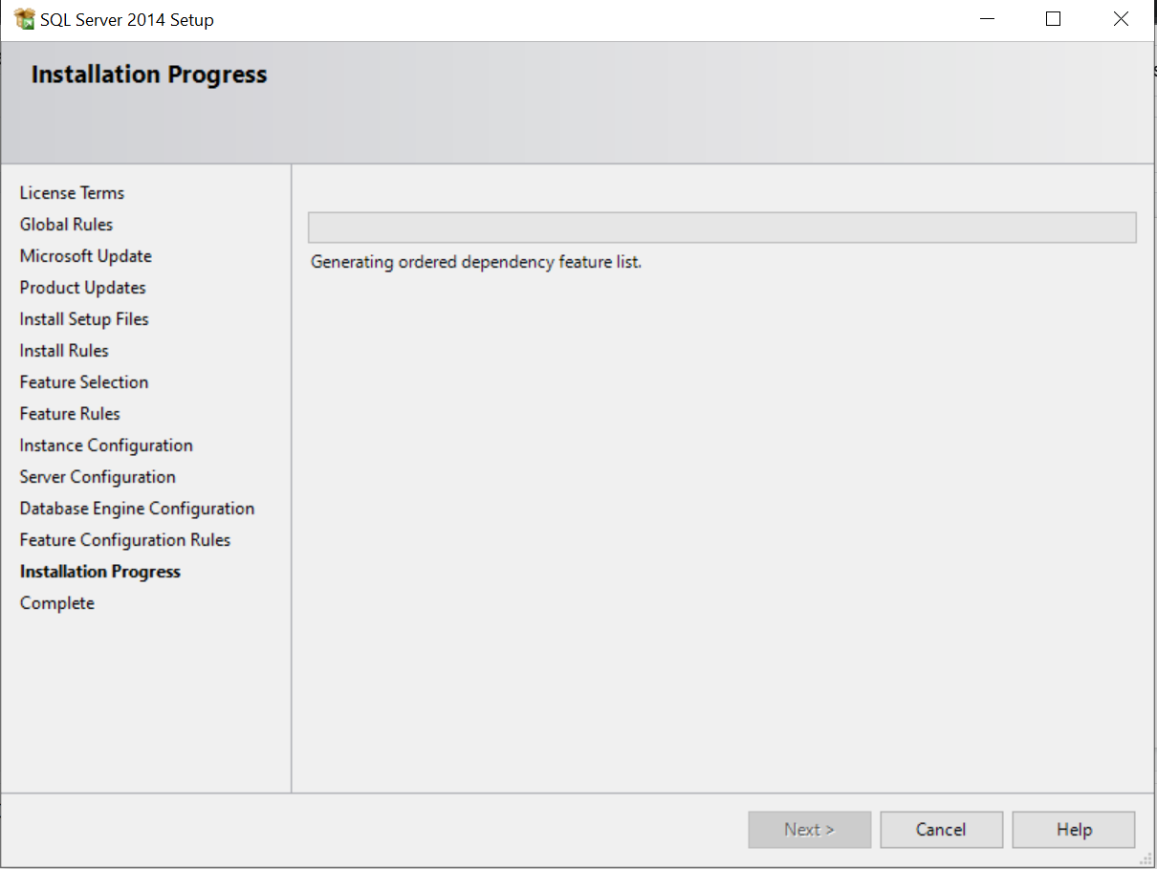

Step 20: Let the installation process get complete

Slide 22

Step 21: Let the installation process get complete and then click next

Slide 23

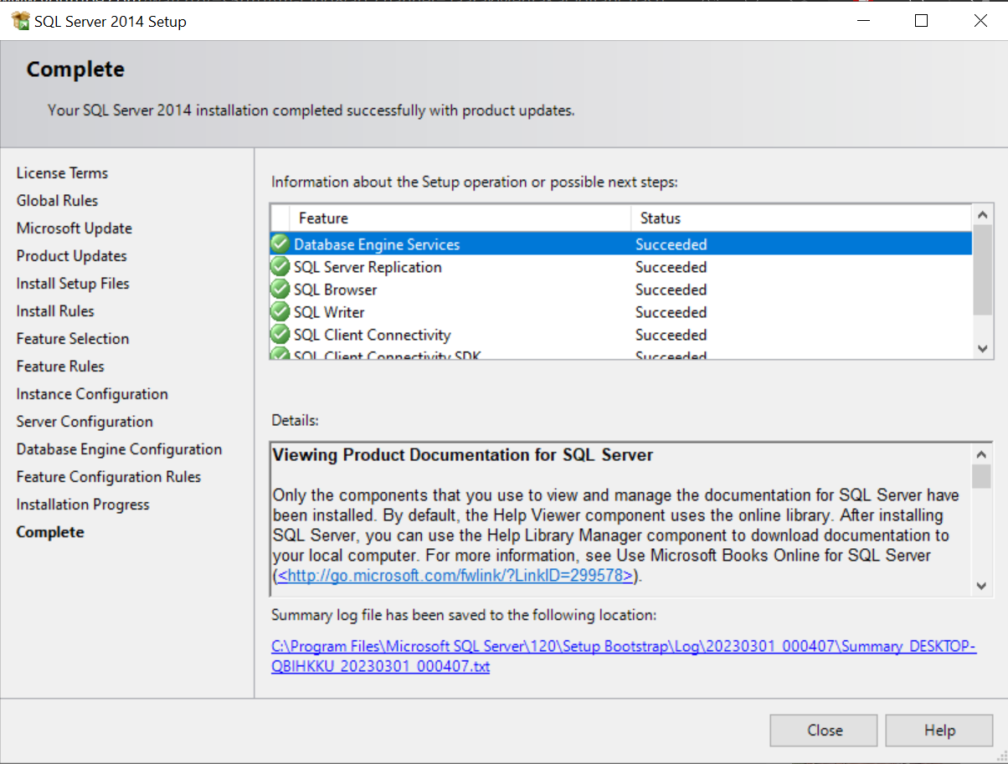

Step 22: Hurray! you have completed the SQL Server Setup and then click on close

Slide 24
Step 23: Go to the folder where it got downloaded again and click on SQLManagementStudio.exe

Slide 25

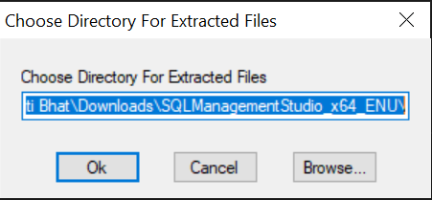

Step 24: Click on Ok

Slide 26
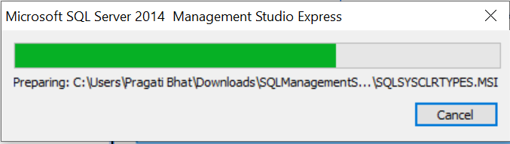

Step 25: Let it download

Slide 27

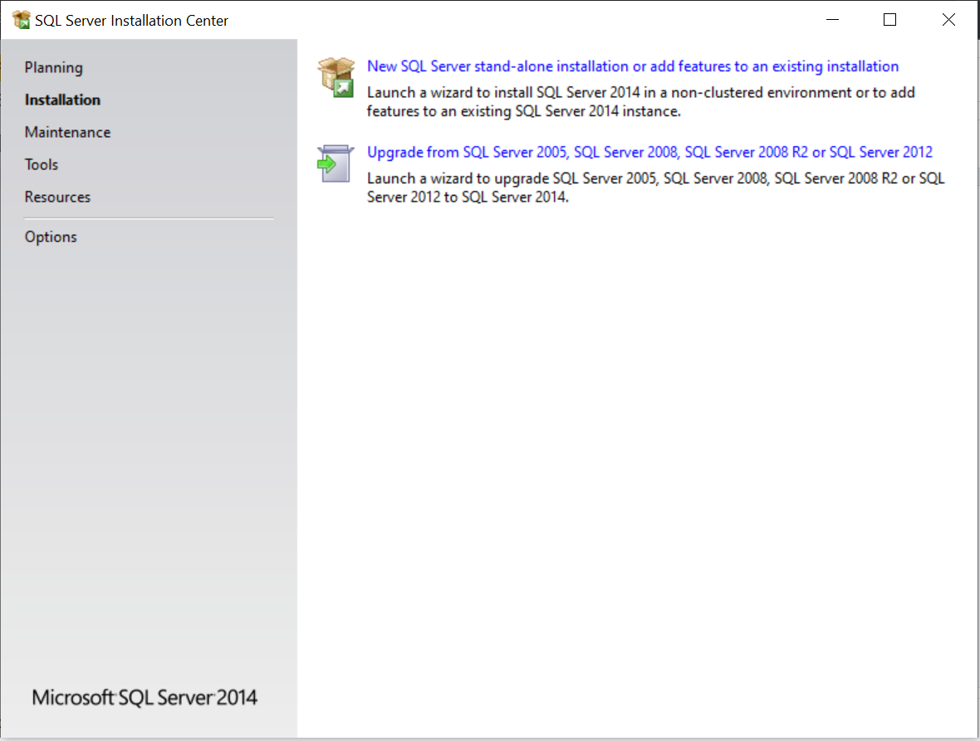

Step 26: Click the first link

Slide 28

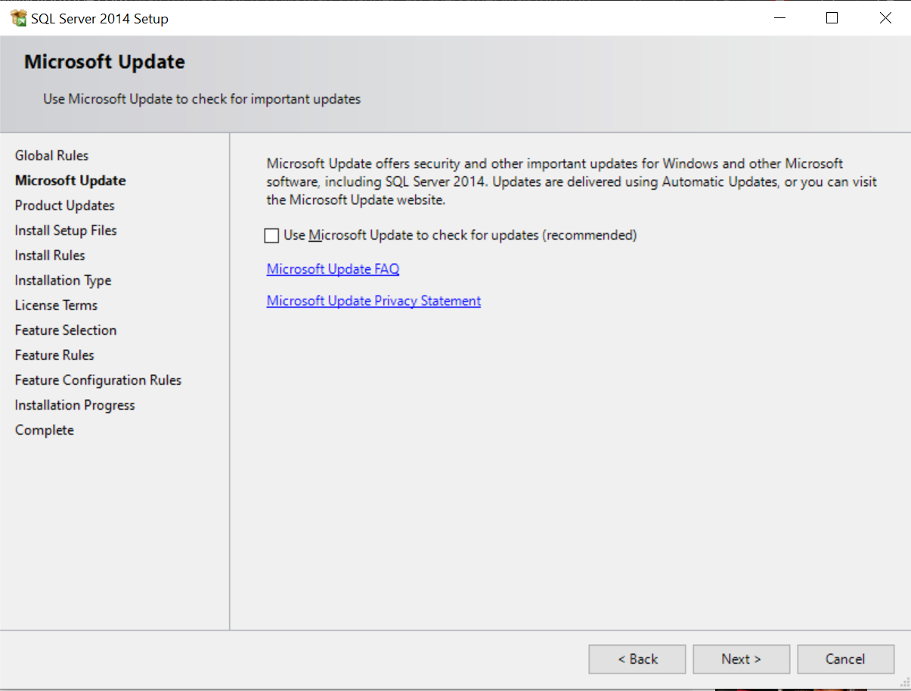

Step 27: Click on next

Slide 29
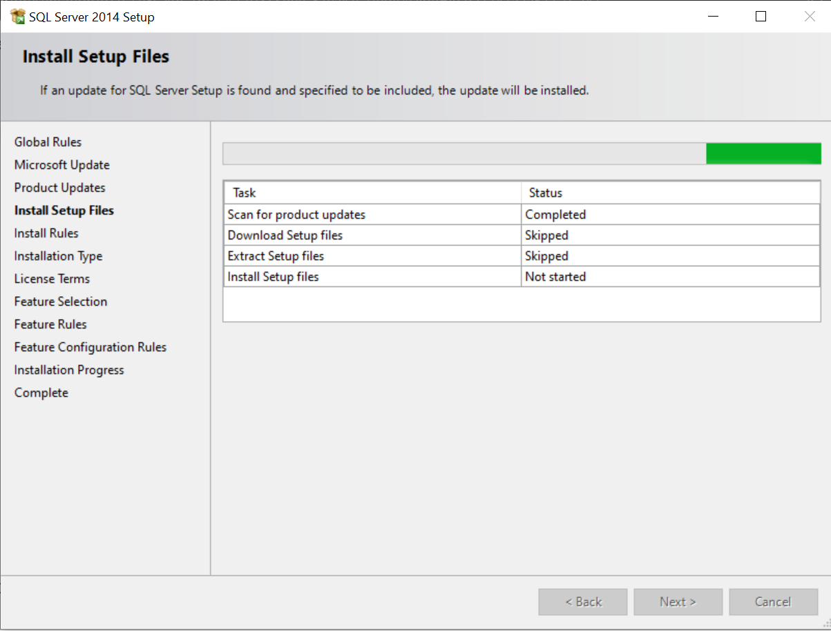

Step 28: Let setup files get downloaded

Slide 30
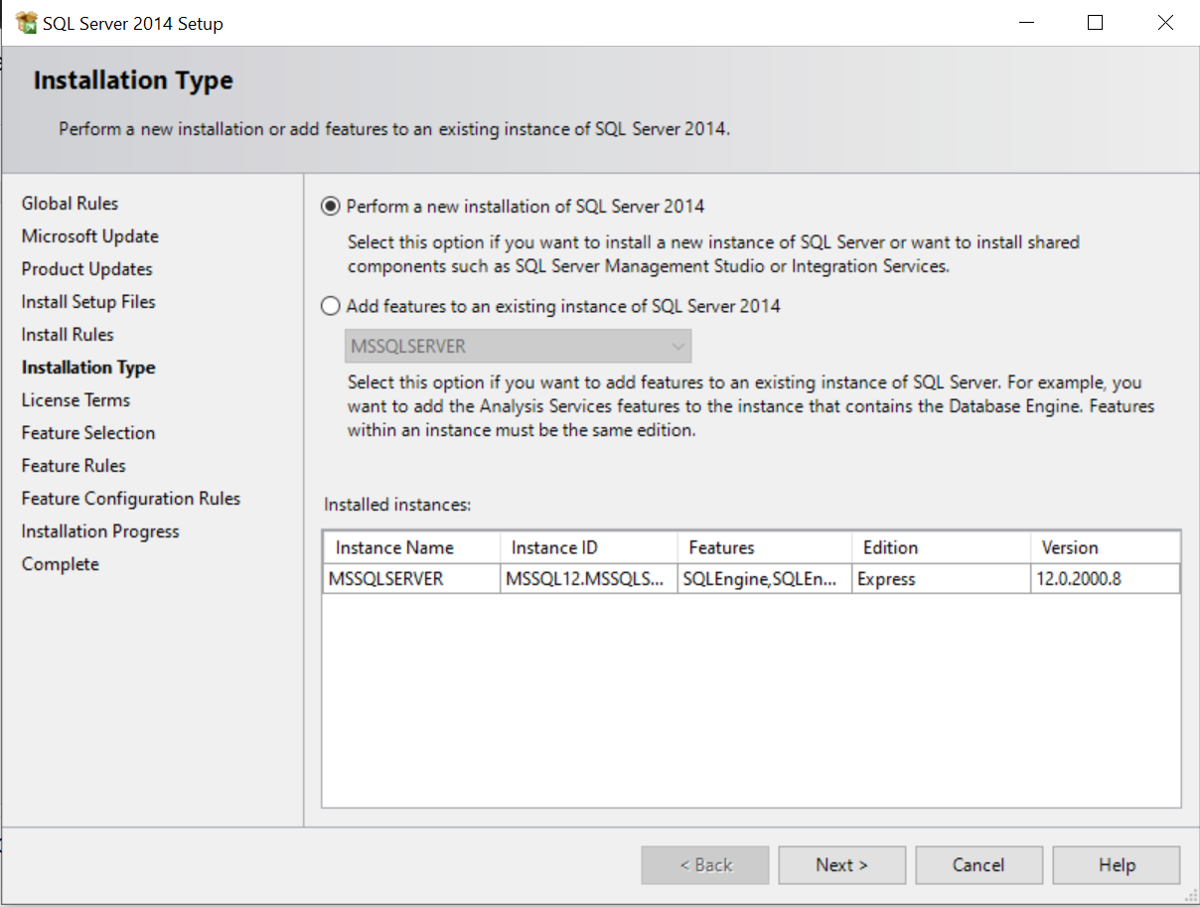


Step 29: Click on next

Slide 31
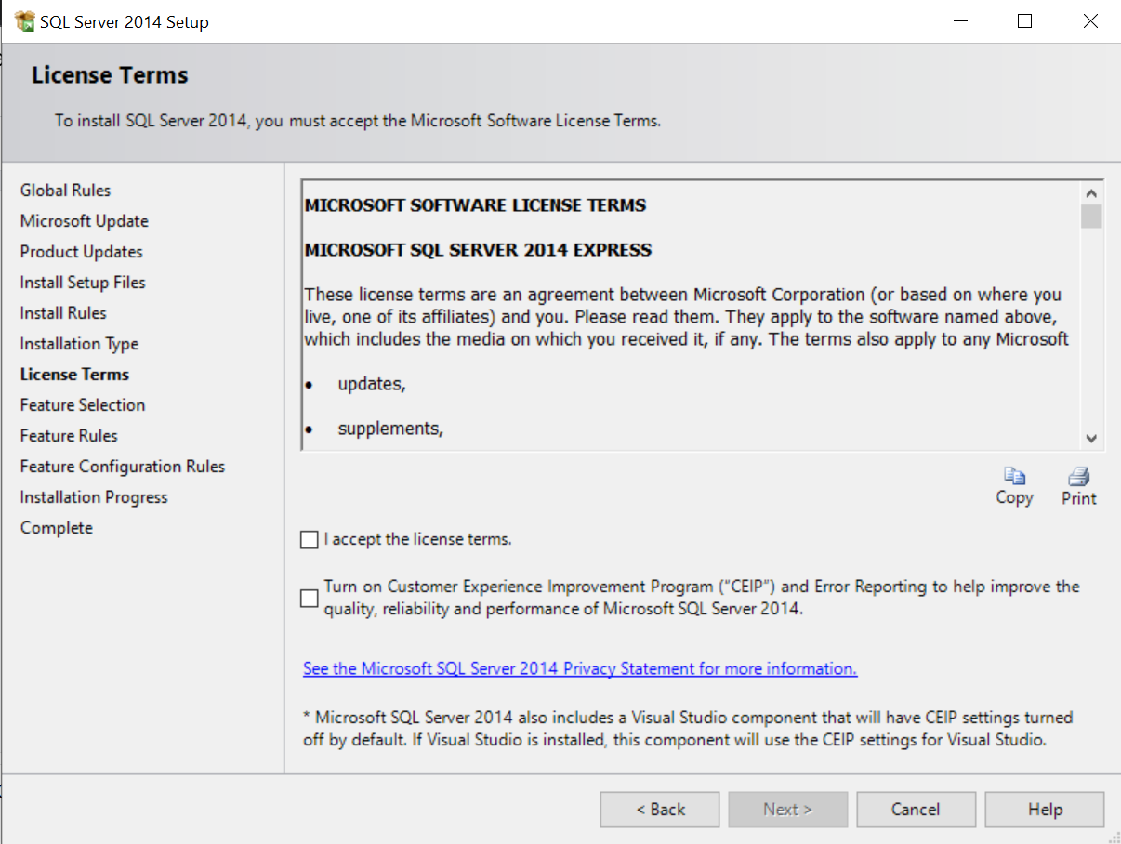

Step 30: Click on I accept the license terms and click next

Slide 32

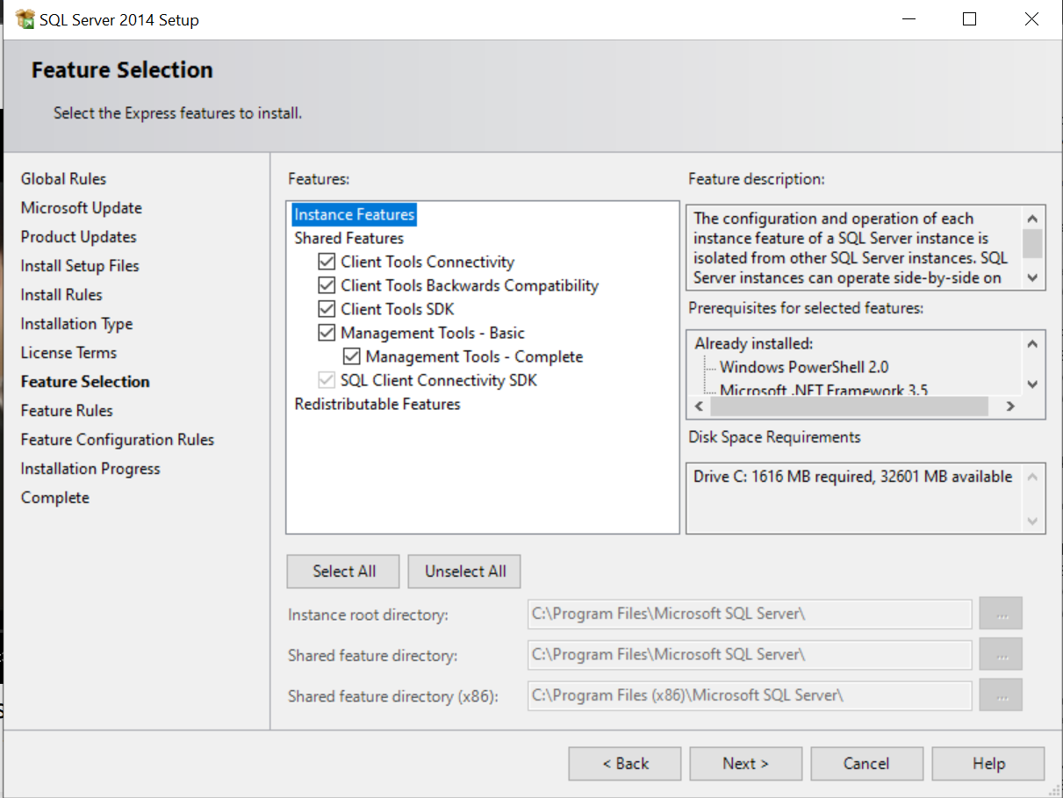
Step 31: Select all the features and select next

Slide 33
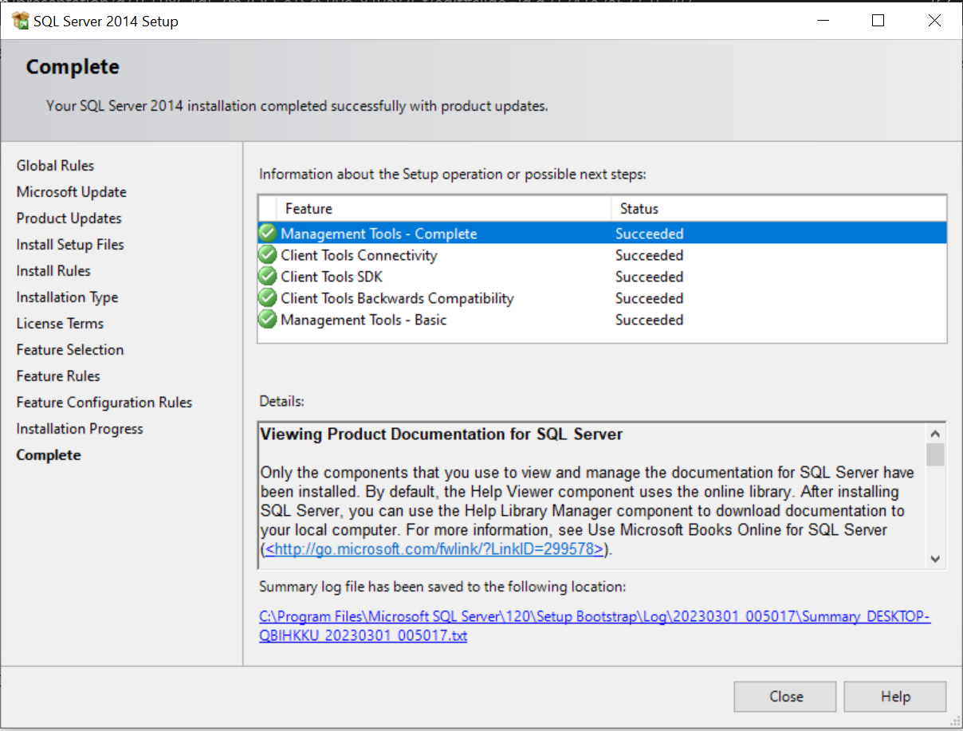

Step 32: Hurray! you have completed the SQL Management Studio Setup and then click on close

Slide 34

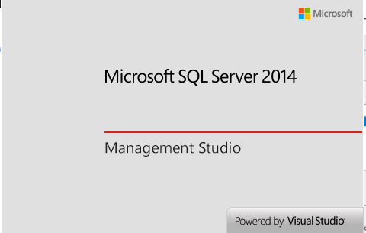
Step 33: Go to search bar and type SQL Management Studio and click enter , the studio will start

Slide 35
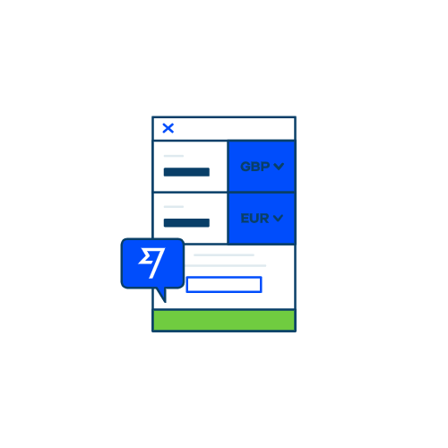
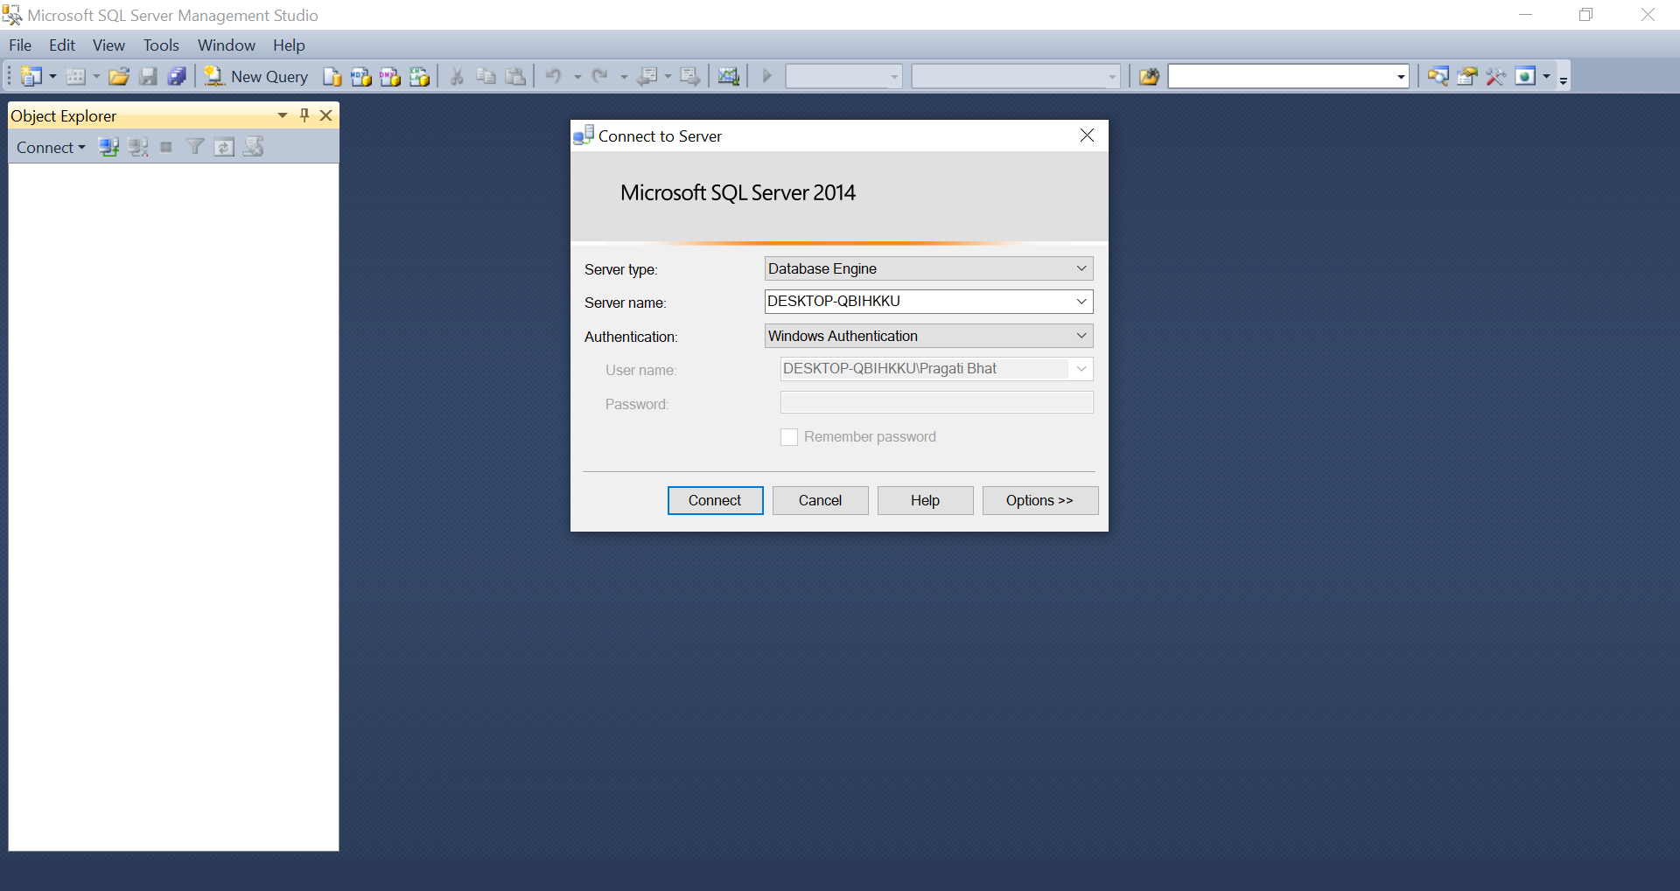

Step 34: Your screen will look like below image

Slide 36
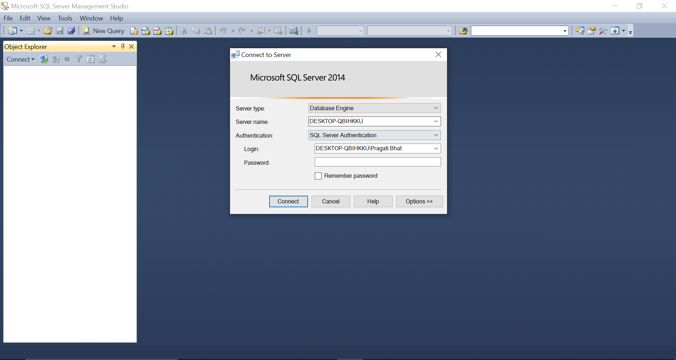

Step 35: Select Authentication as SQL Server Authentication,enter login - sa and password- the one you have kept in earlier steps and click connect

Slide 37



Step 36: If you forgot your password you can keep authentication as Windows and click on connect

Slide 38

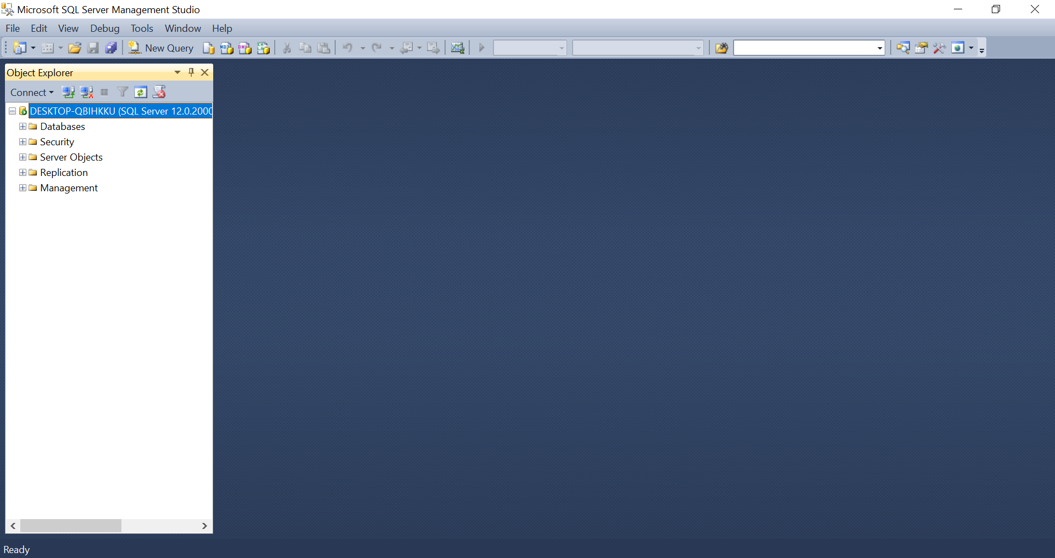
Step 37: Hurray! you have successfully installed SQL Server

Slide 39

THANK YOU

